Slide 1
Decision Tree and random forest Classifier

Slide 2
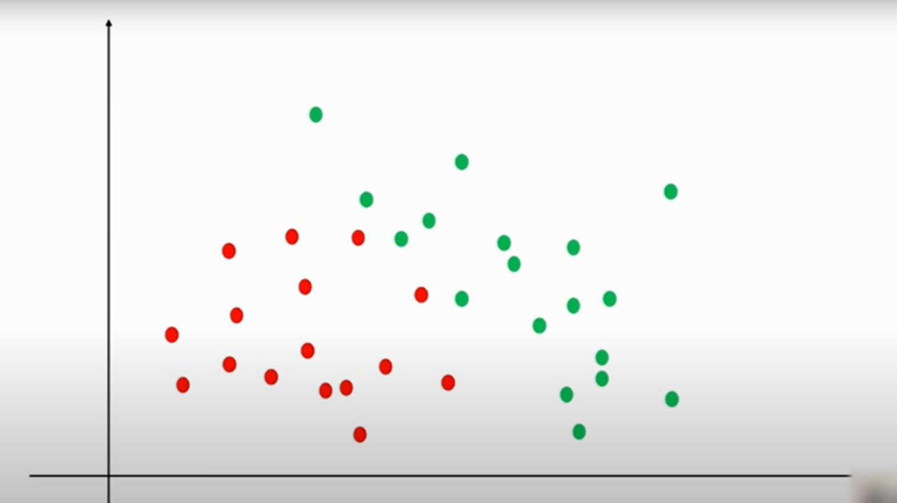
Easy to draw a decision boundary using logistic regression

Slide 3
Easy to draw a decision boundary using logistic regression

Slide 4
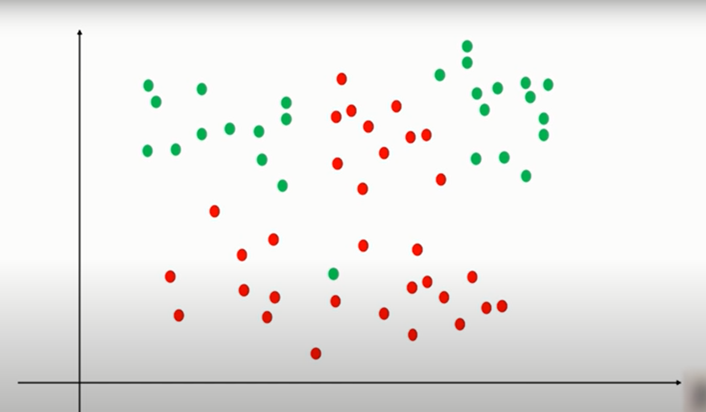
What if a dataset is this?

Slide 5
You may have to split the data again and again to get the properly classified data

Slide 6
Company | Job | Degree | Salary more than 100k
google | sales executive | bachelors | 0
google | sales executive | masters | 0
google | business manager | bachelors | 1
google | business manager | masters | 1
google | computer programmer | bachelors | 0
google | computer programmer | masters | 1
abc pharma | sales executive | masters | 0
abc pharma | computer programmer | bachelors | 0
abc pharma | business manager | bachelors | 0
abc pharma | business manager | masters | 1
facebook | sales executive | bachelors | 1
facebook | sales executive | masters | 1
facebook | business manager | bachelors | 1
facebook | business manager | masters | 1
facebook | computer programmer | bachelors | 1
facebook | computer programmer | masters | 1

Slide 7
Salary>100K ?
Company
Google
Facebook
ABC Pharma
google | sales executive | bachelors
google | sales executive | masters
google | business manager | bachelors
google | business manager | masters
google | computer programmer | bachelors
google | computer programmer | masters
facebook | sales executive | bachelors
facebook | sales executive | masters
facebook | business manager | bachelors
facebook | business manager | masters
facebook | computer programmer | bachelors
facebook | computer programmer | masters
abc pharma | sales executive | masters
abc pharma | computer programmer | bachelors
abc pharma | business manager | bachelors
abc pharma | business manager | masters
?
YES
?

Slide 8
Here by looking at previous tree we can say that Facebook is always paying more than 100K salary to their employee irrespective of the job or degree
But for Google and abc pharma we need to ask further questions, like based on which other attribute they are giving the salary?

Slide 9
Salary>100K ?
Company
Google
Facebook
Abc pharma
Business manager
YES
Computer programmer
Sales executive
NO
google | business manager | bachelors
google | business manager | masters
google | computer programmer | bachelors
google | computer programmer | masters
google | sales executive | bachelors
google | sales executive | masters

Slide 10
Now again in this case further level of hierarchy shows, in Google,
business managers get salary>100K
Sales executives do not get salary>100k
And for computer programmers we need to do further classification based on some other features

Slide 11
Salary>100K ? (further we get following classification
Company
Google
Facebook
YES
Abc Pharma
Business Manager
YES
Computer programmer
Sales Manager
NO
Bachelors
NO
Masters
YES
Business Manager
Sales Manager
Business Manager
NO
Bachelors
NO
Masters
YES
Computer Programmer
NO

Slide 12
We can do this iteratively to get the final classification of the data
Here we had only three attributes, but what if e have 50 attributes
It matters in which order we split the decision tree
Here we did company first then job title and then degree
Performance of the algorithm depends on order of attributes also

Slide 13
How to select ordering of the feature? Take following example
Here Entropy is measure of randomness in data
Company
Facebook
Abc pharma
facebook | sales executive | bachelors
facebook | sales executive | masters
facebook | business manager | bachelors
facebook | business manager | masters
facebook | computer programmer | bachelors
facebook | computer programmer | masters
abc pharma | sales executive | masters
abc pharma | computer programmer | bachelors
abc pharma | business manager | bachelors
abc pharma | business manager | masters
6/0 = low entropy
1/3

Slide 14
Degree
Bachelors
Masters
google | sales executive | bachelors
google | business manager | bachelors
google | computer programmer | bachelors
abc pharma | computer programmer | bachelors
abc pharma | business manager | bachelors
facebook | sales executive | bachelors
facebook | business manager | bachelors
facebook | computer programmer | bachelors
google | sales executive | masters
google | business manager | masters
google | computer programmer | masters
abc pharma | sales executive | masters
abc pharma | business manager | masters
facebook | sales executive | masters
facebook | business manager | masters
facebook | computer programmer | masters
4/4 = high entropy
6/2

Slide 15
So, if we split by company first we get high gain
And if we split by degree first we get low gain
Accordingly we should select the order of attributes

Slide 16
Random forest
It’s a popular ML algorithm in regression and classification models
Forests are made up of trees, here in ML forest is of decision trees
In earlier example we build a decision tree to predict salary > 100k
We can build multiple decision trees from the same datasets
We will get different decisions from different trees
Then random forest algorithm will take majority vote and make final decision

Slide 17
To learn random forest algorithm we will use sklearn’s ‘digits’ dataset to classify the images
The dataset contains some images of some handwritten characters and out code will classify them into 0 to 9 digits categories

